Slide 1
Battle of the Neighborhoods
Toronto VS New York

Slide 2
Problem Statement
Understand the Similarities and Differences between Neighborhoods in Scarborough, Toronto and Queens, New York
Select the best neighborhood for a family who wants to move to Toronto or New York

Slide 3
Objectives
Collect the neighborhoods top venues using Foursquare
Form neighborhoods based on venue categories using k-means clustering algorithm
Identify and understand similarities and differences between Scarborough and Queens neighborhoods to be able to decide which is the best option

Slide 4
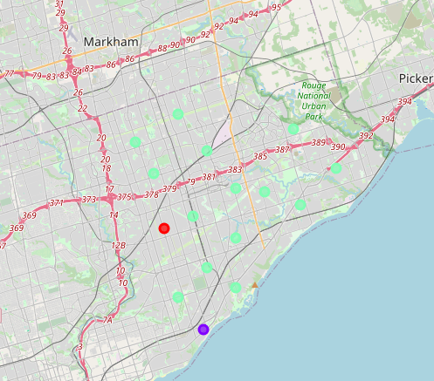
Scarborough Map
Different neighborhoods clusters

Slide 5
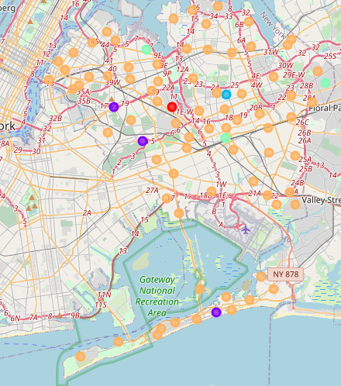
Queens Map
Different neighborhood clusters

Slide 6
Comparison between neighborhoods Scarborough vs Queens
Scarborough has 80 distinct venues in 55 categories with the most common being coffee shops, skating rinks, and international restaurants.
Queens has 1736 distinct venues in 277 categories with the most common being bakeries, coffee shops, and parks.

Slide 7
Conclusion
Based on the quantity and variety of venues Queens is a much better places for the family to move to than Scarborough. Queens offer much more for them to have a higher life quality and easy access to everything.

